Slide 1
Optimization pipeline design from data curation to algebraic modeling with GAMSPy
Atharv Bhosekar, PhD
Adam Christensen, PhD

Slide 2
Use GAMSPy in your academic life?
Submit awesome code to academic@gams.com
Win an iPad!
Deadline - April 1, 2025
Award - May 15, 2025

Slide 3
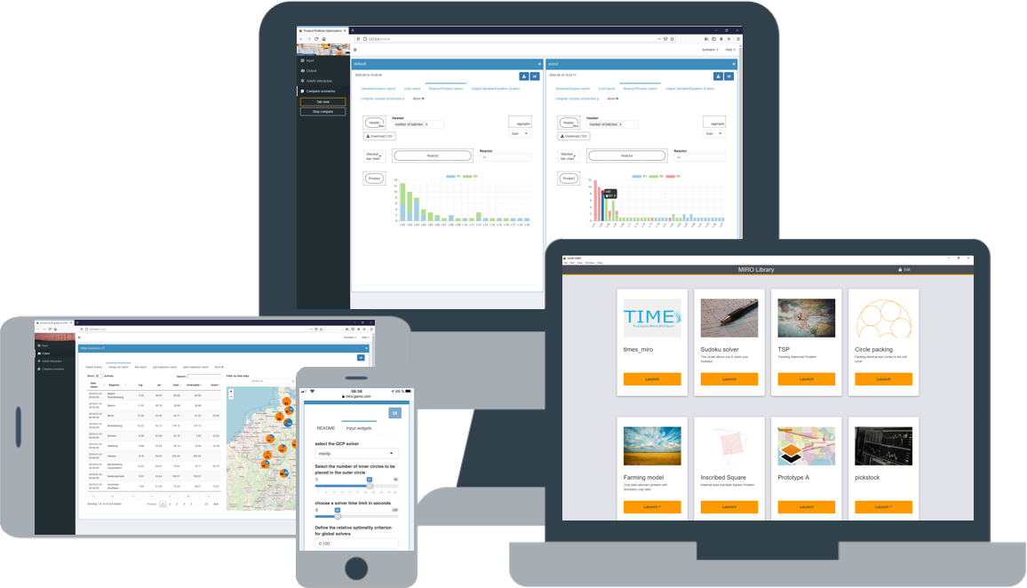
The GAMS Ecosystem
Modeling Platform
Platform Independent Algebraic Modeling Language for Domain Experts
Commercial and Academic Solvers (packaged)
APIs for major programming languages (C++, Java, Python, Matlab and more)
Graphical UI Generator
Turns models into web applications for end users
Extendable with custom code
Local or Server Installation
Mathematical Modeling in Python
Uncompromised performance
Seamless pipeline management
Deployment Solution
Solves GAMS models on centralized resources (on-prem or cloud)
REST API (user & job management)
GAMS job scheduling & Load balancing
Gateway REST API
3
2
1
Notes:
A través de los años hemos creado un ecosistema completo con una plataforma de modelaje, Luego con tal de permitir que non-expertos puedan beneficiar de nuestra tecnología creamos un generador de Interfaz para usuario que se llama MIRO Con las tendencias actuales hemos desarrollado soluciones para servidores (en sitio o en la nube) asi que GAMESPy, lo cual mi colega Atharv les va a comentar mas en detalle en un momento.

Slide 4
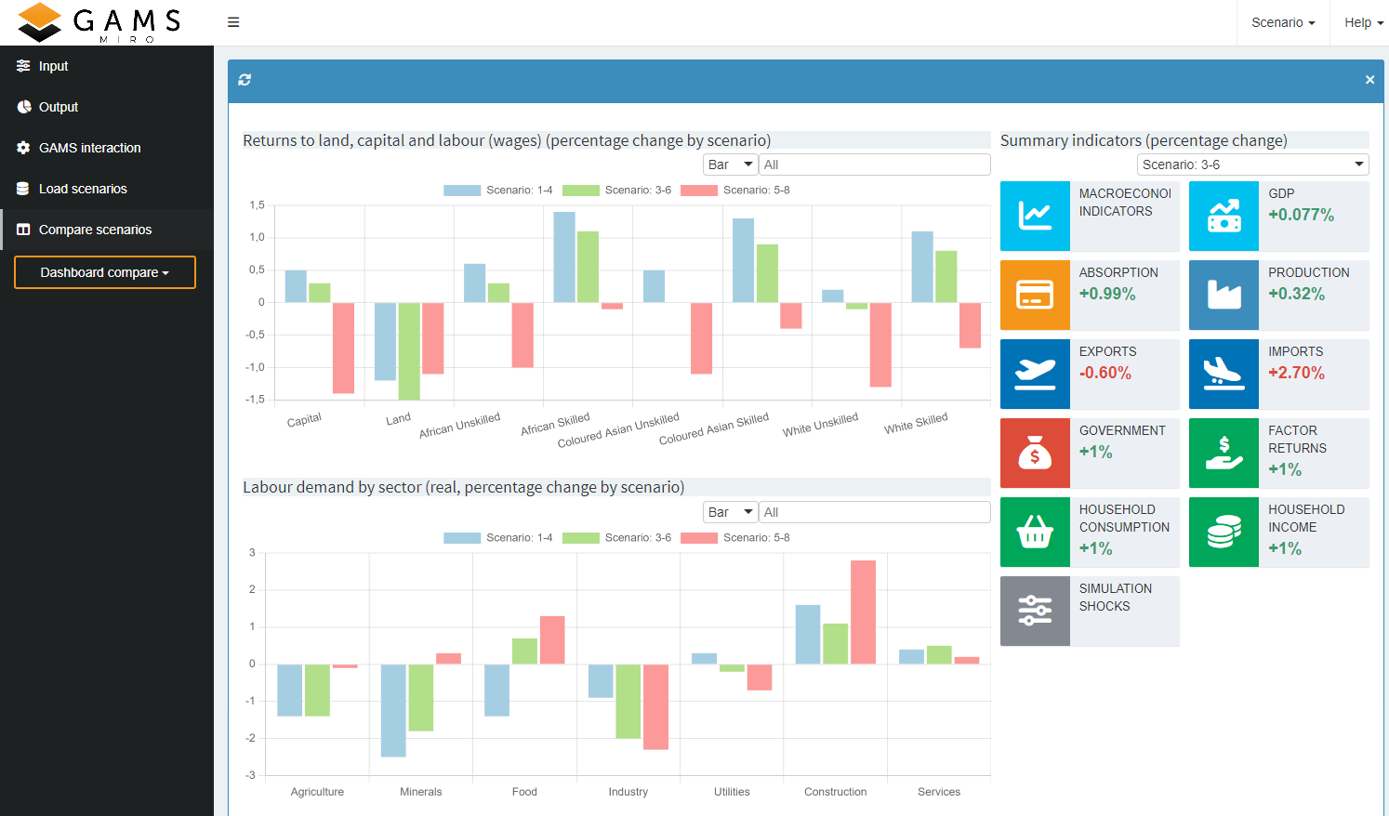
Solving Complex Real-World Problems
Is not all about the model itself
Data cleaning
Data manipulation
Data visualization
Notes:
Well all know this: Applied mathematical optimization involves solving complex real-world problems and it would be nice if it was just all about the model itself. But I don’t have to tell you that we all have to take care of many other things, such as careful handling and visualization of data.

Slide 5
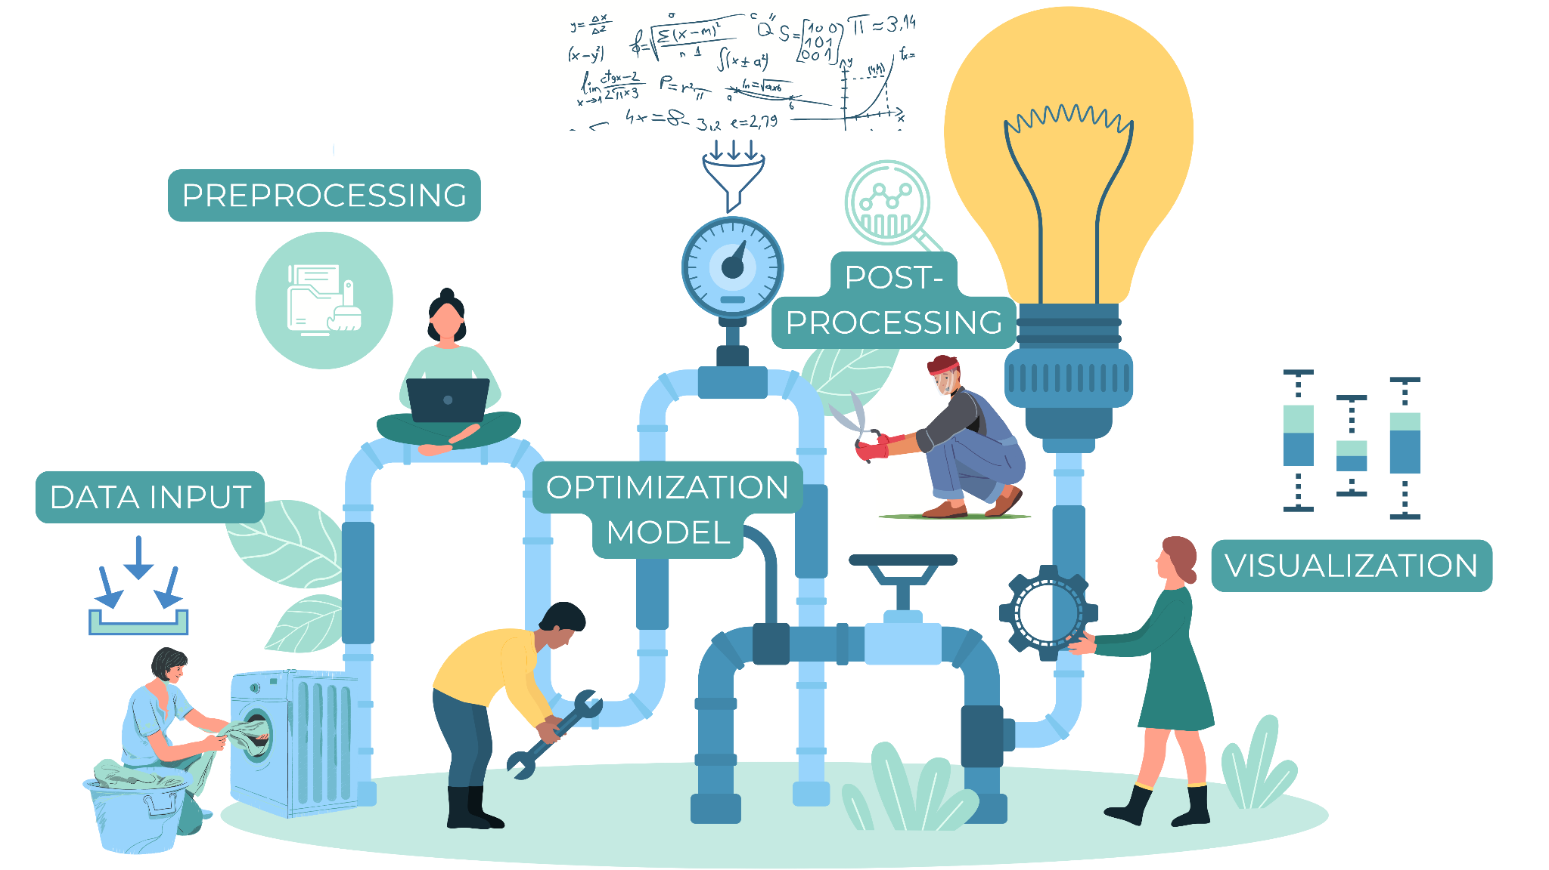
Optimization Pipeline
Notes:
And after hours of implementing and developing, we end up with this huge optimization pipeline that includes reading data, preprocessing data with various tools, and the mathematical model in a language such as GAMS, and again postprocessing and visualization in another language or environment.

Slide 6
Python
Very often a shared language by a diverse organization-spanning group
Vast array of packages to handle tasks in the optimization pipeline
Communication with GAMS is seen as a bottleneck
Notes:
So let’s be honest: Data manipulation, preprocessing, and postprocessing can be time-consuming and tedious, especially when working with a domain-specific modeling language such as GAMS.

Slide 7
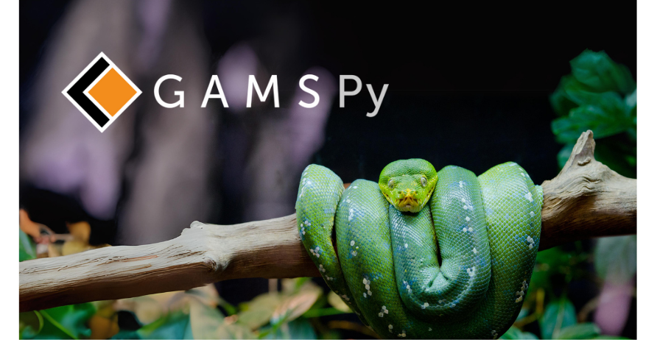
Comfortable & Performant Modeling in Python

Slide 8
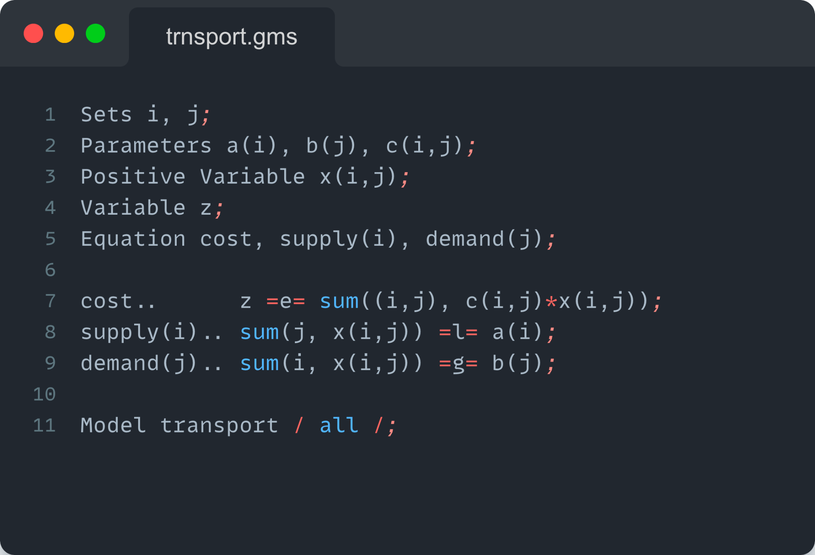
What is GAMS?
Abstract Model
Declared/defined over sets
Like “writing on paper”
Compact
Logically consistent (no domain violations, uncontrolled sets)
Completely abstract (no data)

Slide 9
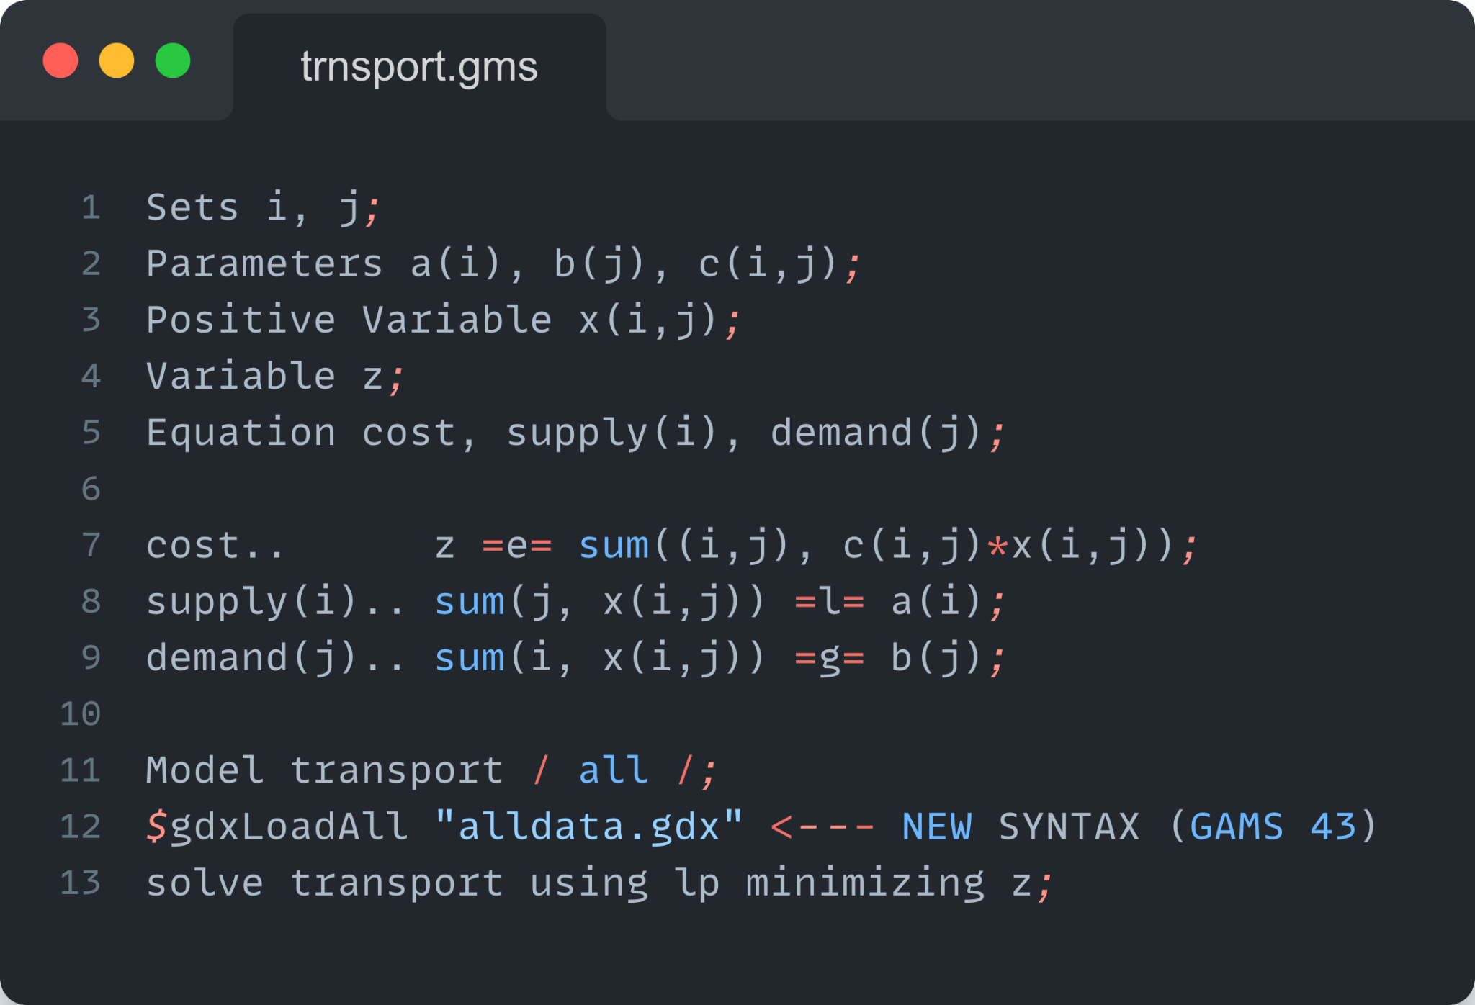
What is GAMS?
Model Instance
Add all the data 🔥🚒
Model generated at solve
GAMS Philosophy - tight syntax leads to better modeling

Slide 10
The GAMS System – The Good
Algebraic Modeling Language (AML)
Backward compatibility – stable!
Active development since 1987 – stable!
Familiar syntax – human readable!
Data is held in GAMS structures - fast!
GAMS structures – very large models!
😇

Slide 11
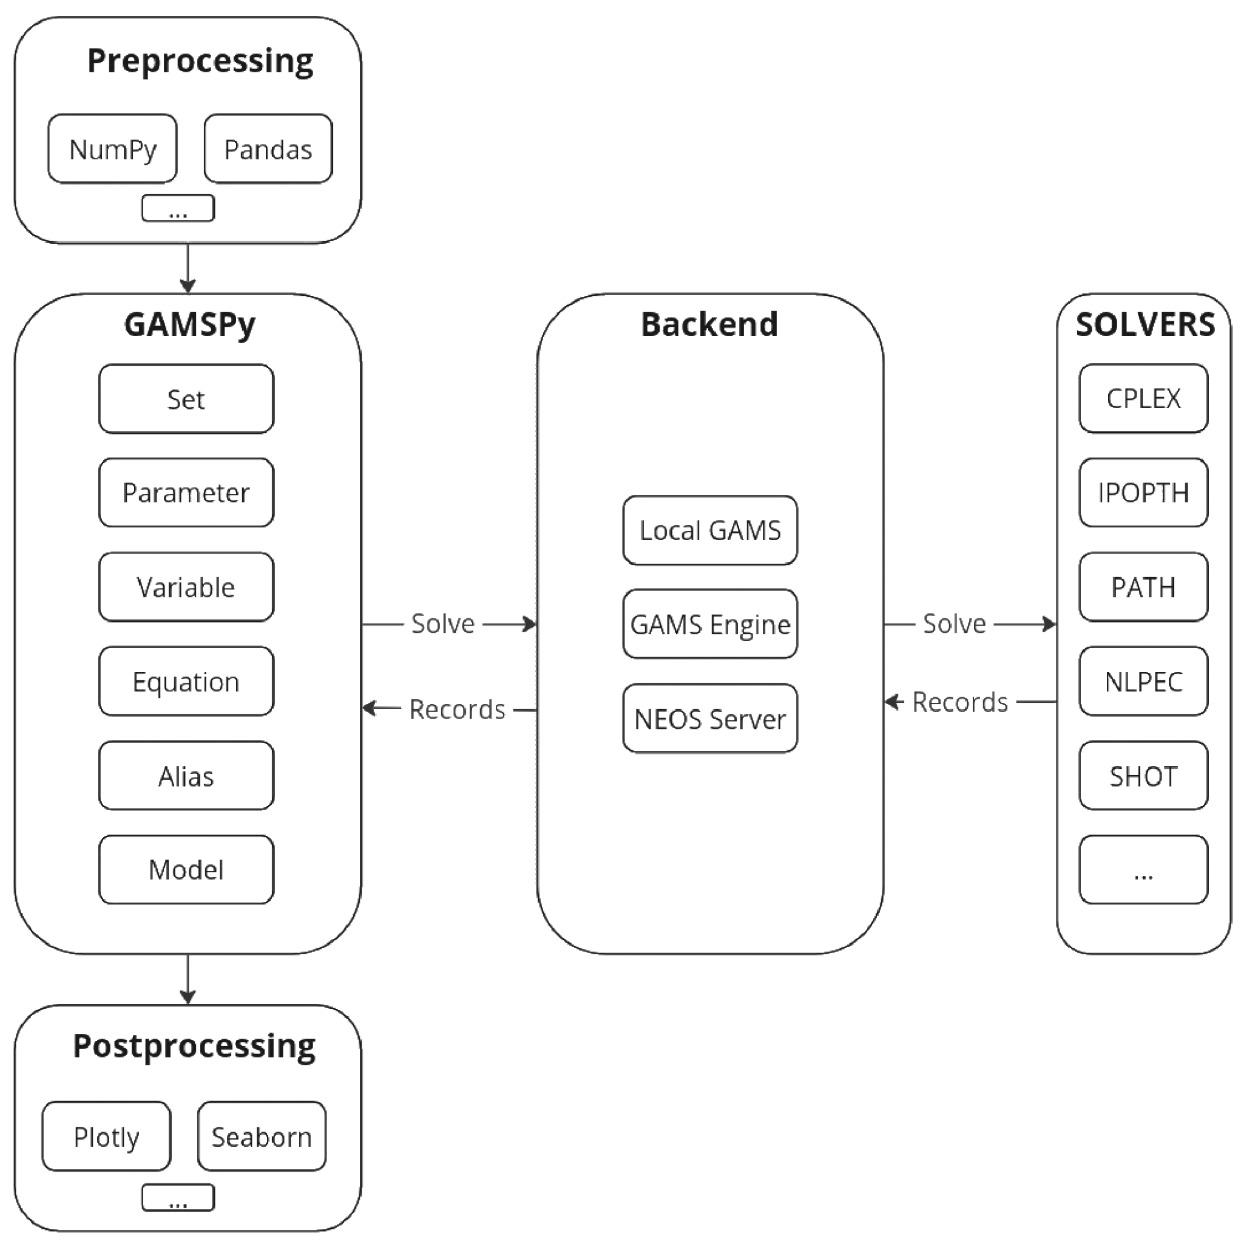
What is GAMSPy?
Python-based Algebraic Modeling Language (AML)
Abstract/data-independent modeling
Convenient handling of sparse data
Streamlined optimization pipeline management
Convenient and efficient data structures (Numpy, Pandas)
Runs with a specialized engine (GAMS)

Slide 12
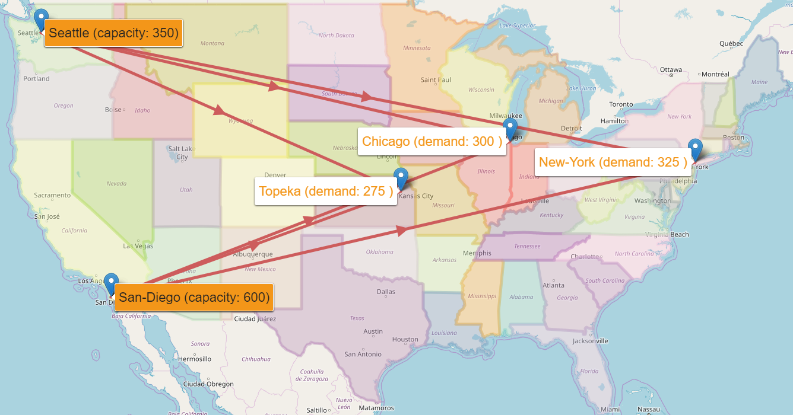
A Simple Transportation Problem
shipments
Canning Plants (supply)
Markets (demand)
(Number of cases)
Freight: $90 case / thousand miles

Slide 13
A Simple Transportation Problem
Supply
(cases)
Distance
(thousand miles)
Demand
(cases)
275
Topeka
1.8
Seattle
350
1.7
1.4
2.5
300
1.8
Chicago
San Diego
600
2.5
325
New York
Freight: $90 case / thousand miles
Minimize Transportation cost
subject to Demand satisfaction at markets
Supply constraints
Notes:
One information we still need to solve the problem is the distance between the production sites and the markets, because transportation cost was given in $ / 1000 miles.
So here we are,
On the left we have our production sites, on the right we have our markets, and we have connections between plants and markets with the distances written along these arrow.

Slide 14
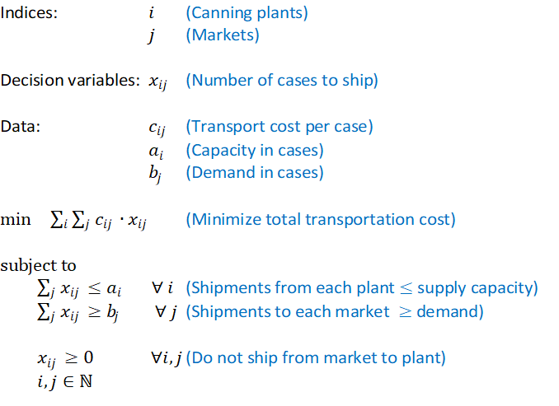
Mathematical Model Formulation
Notes:
Here is the mathematical model formulation.
We have two indices, which are our canning plants (i) and our markets (j).
Our decision variables are xij, i.e. The number of cases to ship from plant i to market j.
Then we have additional data, first cij, i.e. the transport cost per case to ship from plant i to market j,
Then ai, which is the production capacity of plant i
And bj, which is the demand of market j
Our objective is to minimize total transportation cost, which is the sums over i and j of cij * xij,
And we have some constraints, namely the we cannot ship more from plant i than the total production capacity of that plant
We must ship enough to market j to satisfy the demand at that market,
We know that our number of cases shipped from i to j must be positive, i.e. We do not want to ship from a market to a plant.
Now let’s see how this mathematical notation of the model can be expressed in GAMS.

Slide 15
Live Demo
Notes:
I have prepared this model in GAMS. What you see here is our development environment GAMS Studio.
So GAMS models are ascii files, which can of course be edited with any text editor, you can even use notepad if you are so inclined. But Studio has some definited advantages, first of all is syntax highlighting, and the tight integration with GAMS.
Studio is relatively self explanatory, for anyone who has ever used a conventional text editor should feel right at home.
So if we start at the top here, you see the first line starts with a $ sign, followed by Title. This is a so called $ control option, which tells GAMS certain things that are relevant during compile time. This one here, you guessed it, defines a title for our problem, which is then used when GAMS generates its solution report. You could also leave this out, but it is good practice to have a title.
Then we have a bunch of lines that start with an asterisk, which tells GAMS to treat just these lines as a comment.
Then the actual model starts.
Here we have the keyword Sets, which tells GAMS that you are about to declare one or more sets afterwards. This could also be written as lowercase sets because GAMS is case-insensitive, or in the singular form set, depending on your preferences.
Then we have the first set name, “i”, followed by so-called explanatory text. Explanatory text is purely for documenting your model, but is not actually used by GAMS. Following the explanatory text, we have a pair of forward slashes, end between those we have the elements of our set, separated by comma.
On the next line we have the set of our markets, “j”.
[....]

Slide 16
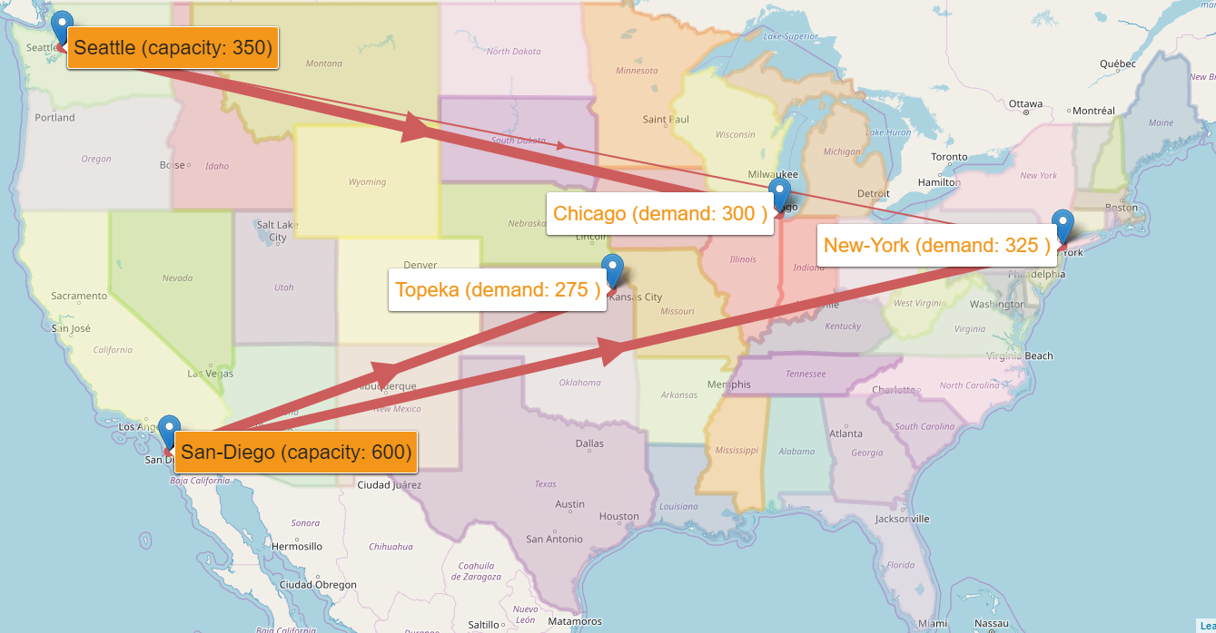
Solution to LP model
shipments
Canning Plants (supply)
Markets (demand)
(Number of cases)
50
300
275
275
Freight: $90 case / thousand miles
Total cost: $153,675

Slide 17
Why GAMSPy? - Ease of installation
Stable version released
Documentation: gamspy.readthedocs.io
Model library (100+ models): https://github.com/GAMS-dev/gamspy-examples

Slide 18
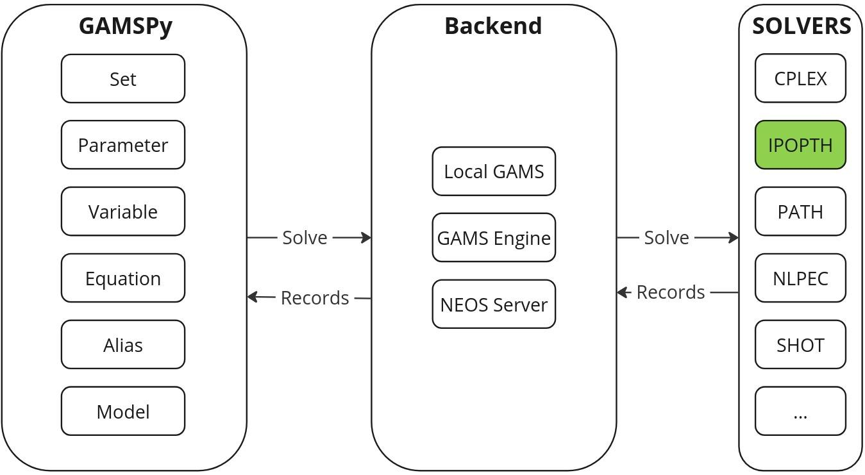
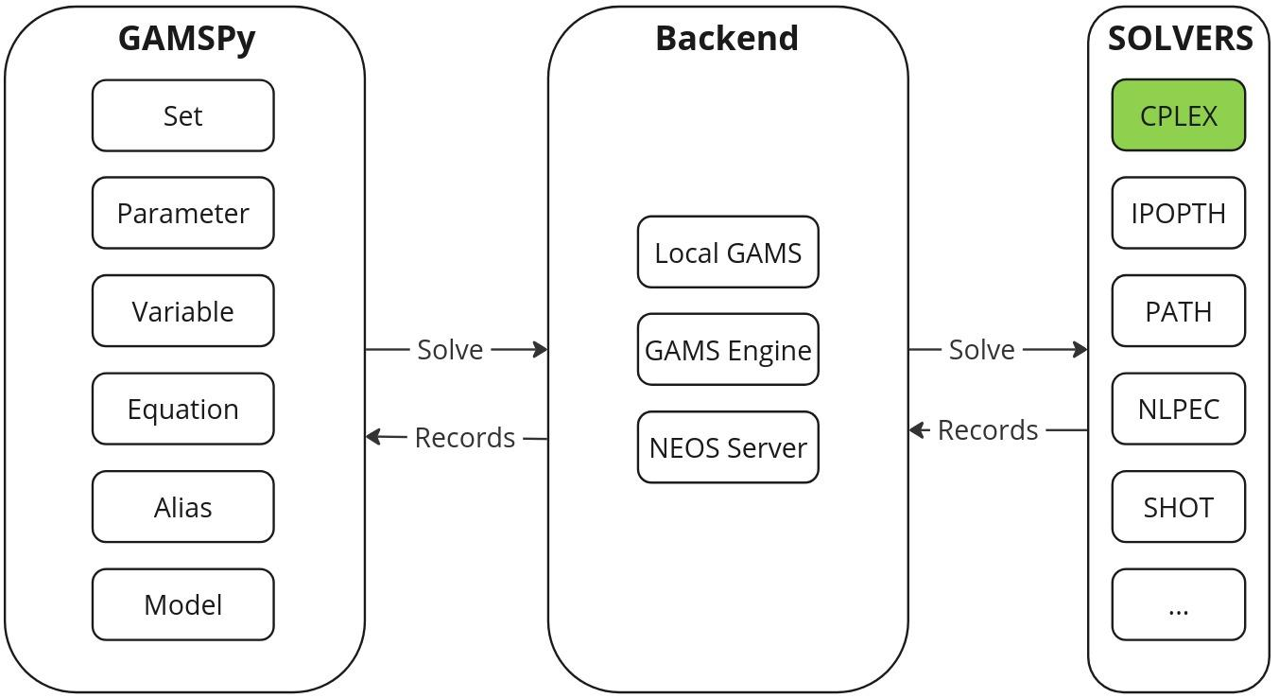
Why GAMSPy? - solver independence

Slide 19
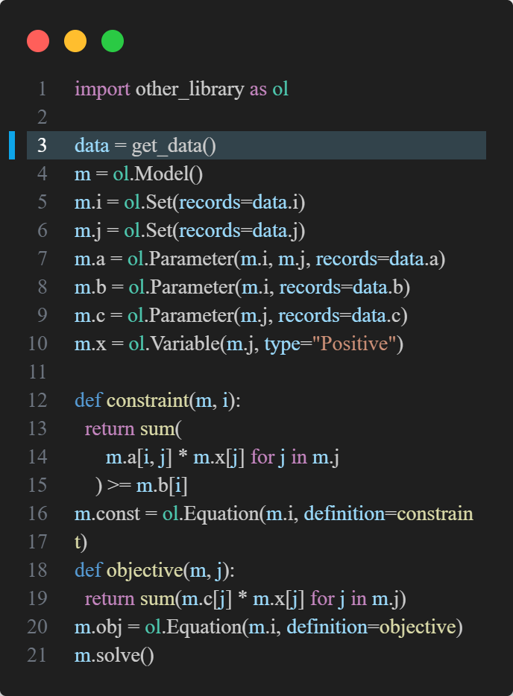
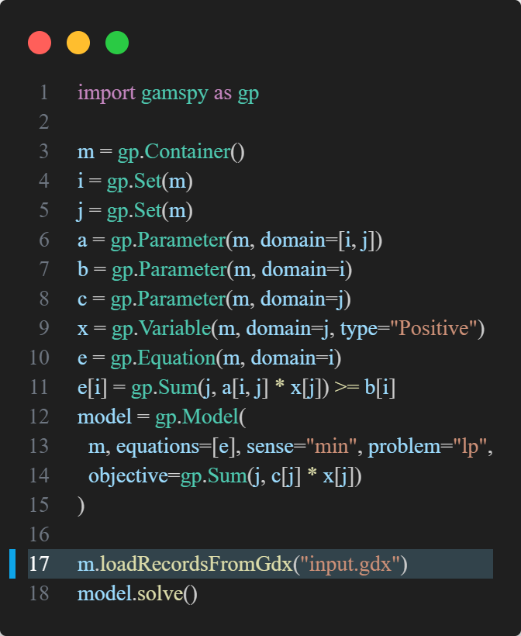
Why GAMSPy? - Data Independence

Slide 20
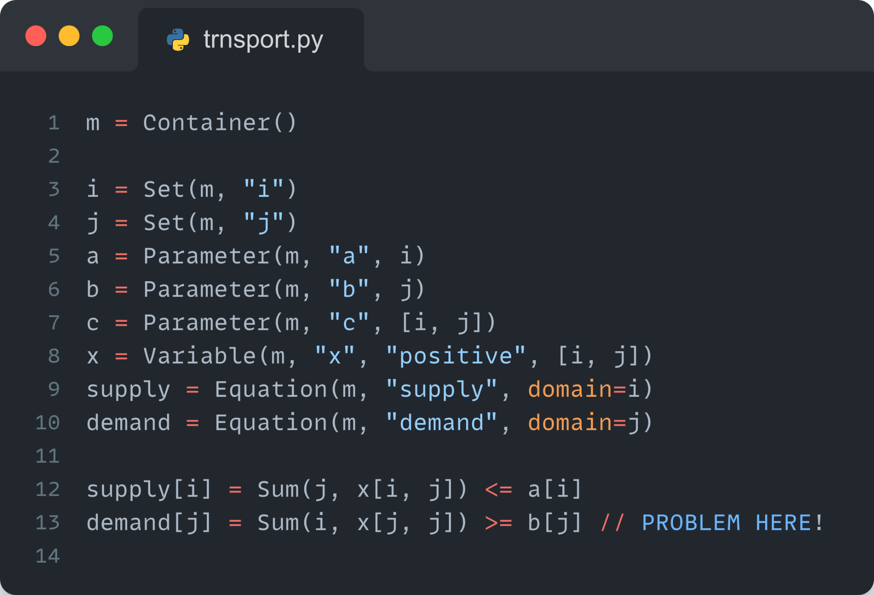
Why GAMSPy? - Convenience
Abstract Model
Declared/defined over sets
Like “writing on paper”
Compact
Logically consistent (no domain violations, uncontrolled sets)
Completely abstract (no data)
Leverages operator overloading

Slide 21
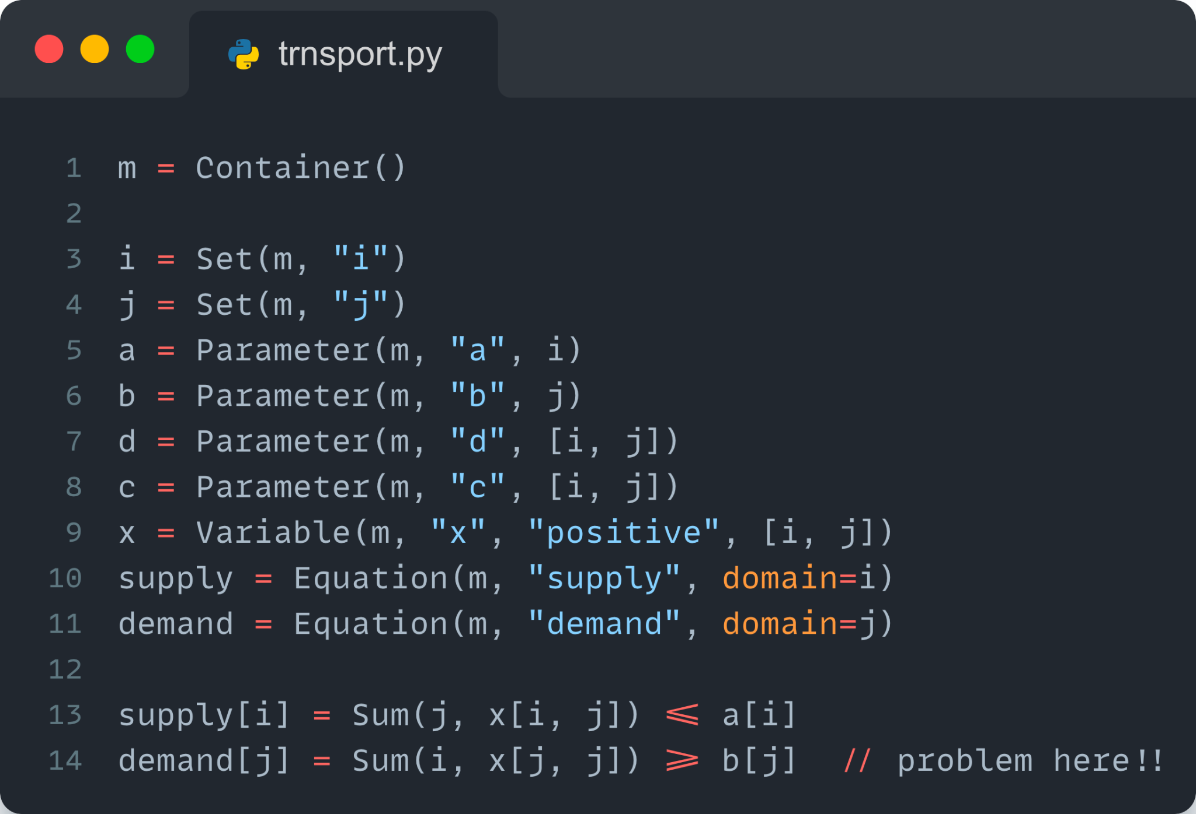
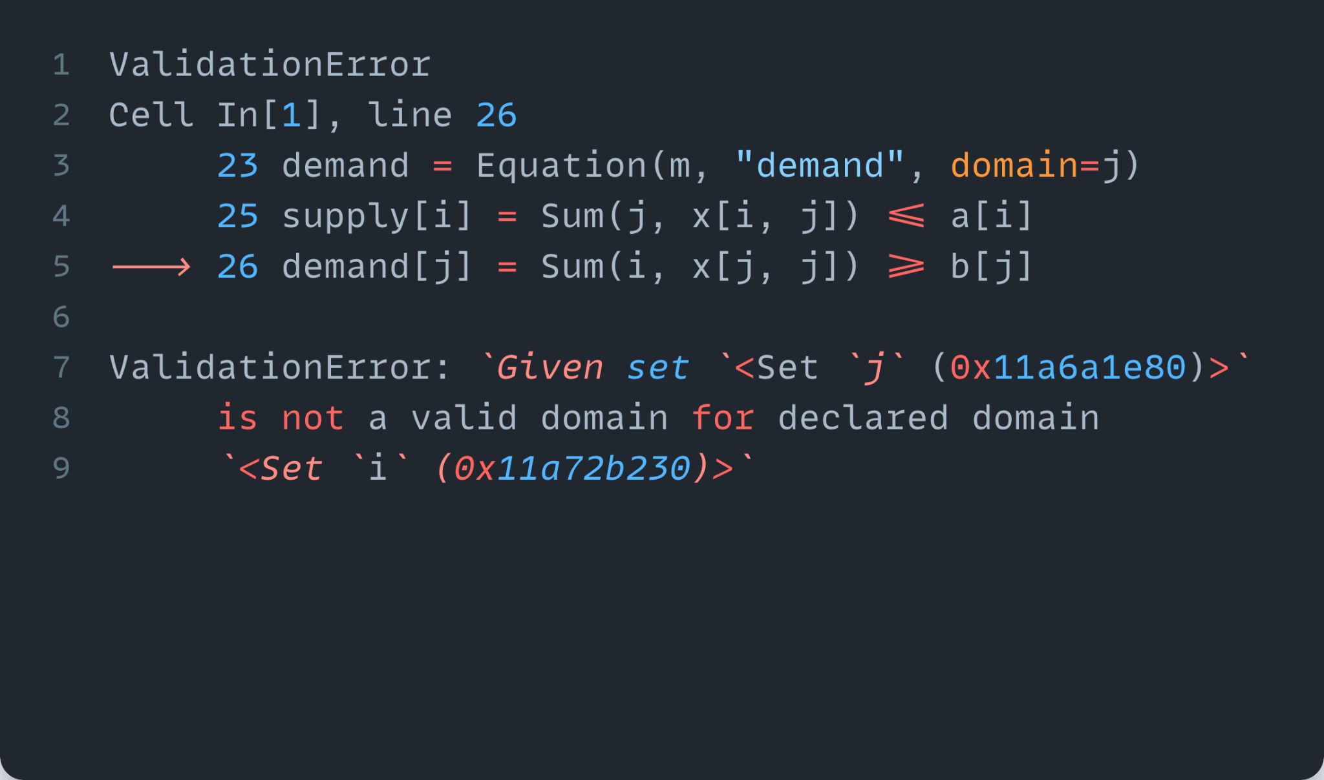
Why GAMSPy? - Convenience
Generates Early Warnings
Domain violation exists
Cannot create equation block
Raises helpful error messages
GAMS Philosophy - tight syntax leads to better modeling

Slide 22
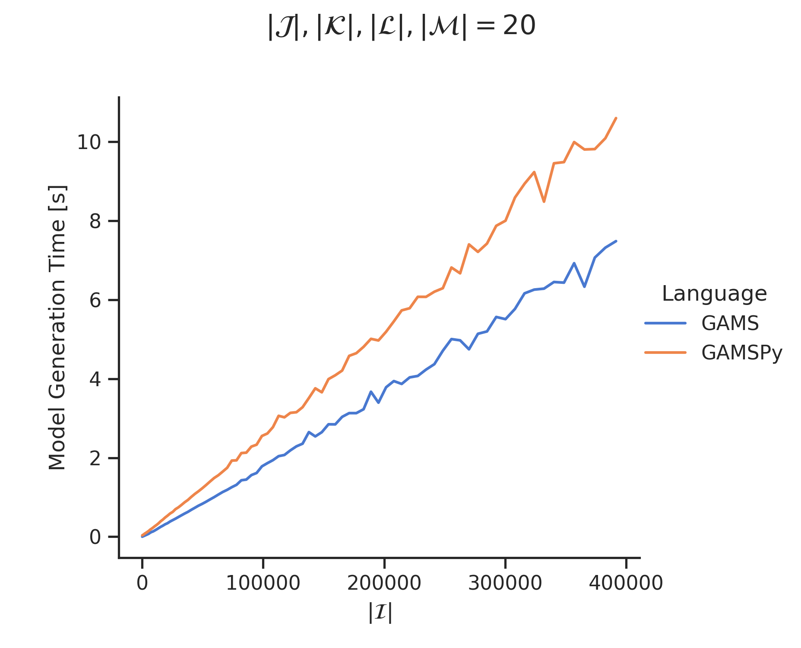
Why GAMSPy? - Performance
blog post for more details

Slide 23
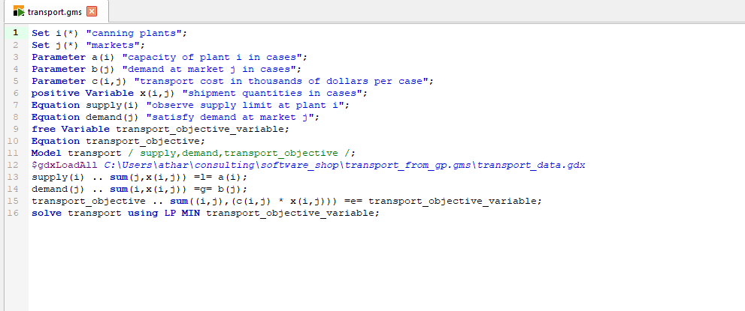
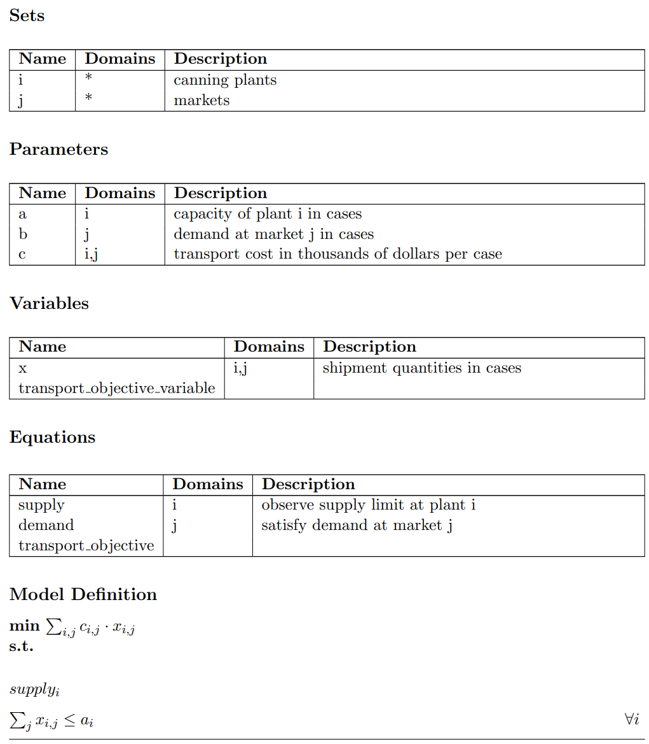
Why GAMSPy? - Interoperability

Slide 24
Why GAMSPy? - Interoperability
Modeling Platform
Platform Independent Algebraic Modeling Language for Domain Experts
Commercial and Academic Solvers (packaged)
APIs for major programming languages (C++, Java, Python, Matlab and more)
Graphical UI Generator
Turns models into web applications for end users
Extendable with custom code
Local or Server Installation
Mathematical Modeling in Python
Uncompromised performance
Seamless pipeline management
Deployment Solution
Solves GAMS models on centralized resources (on-prem or cloud)
REST API (user & job management)
GAMS job scheduling & Load balancing
Gateway REST API
3
2
1
Notes:
A través de los años hemos creado un ecosistema completo con una plataforma de modelaje, Luego con tal de permitir que non-expertos puedan beneficiar de nuestra tecnología creamos un generador de Interfaz para usuario que se llama MIRO Con las tendencias actuales hemos desarrollado soluciones para servidores (en sitio o en la nube) asi que GAMESPy, lo cual mi colega Atharv les va a comentar mas en detalle en un momento.

Slide 25
Summary
Generates mathematical models (not instances) – pure representation of mathematical symbols, devoid of specific data
GAMSPy leverages a GAMS backend to execute assignment operations, generate and solve models
Access a broad set of state-of-the-art optimization solvers
Unique and streamlined way to completely tasks like pre/post-processing and visualization – all in a single environment
GAMSPy works seamlessly with GAMS MIRO, GAMS Engine, and NEOS (local machines vs. cloud/AWS machines)
GAMSPy is fully installable with one line – pip install gamspy

Slide 26
Advanced Topics…
Conditional Indexing
Setting Solver Options
Frozen Solves
Performance Considerations
Advanced Data Handling with gamsapi / GAMSPy

Slide 27
Conditional Indexing
Core of GAMS syntax
# Nested/Logical Chains
term $ (logical_condition1 $ (logical_condition2$(...)))
term $ (logical_condition1 and logical_condition2 and ...)
# Left hand side
rho(i) $ (sig(i) <> 0) = (1./sig(i)) - 1;
# Right hand side
a = 2 $ (b > 1.5);
# Within Equations
sb(i).. sum(j $ ij(i,j), x(i,j)) =l= s(i);
# Over Domain of Definition
gple(w,wp,te) $ ple(w,wp).. yw(w,te) - yw(wp,te) =l= dpack;

Slide 28
Conditional Indexing
Core of GAMS syntax
# Nested/Logical Chains
term.where[logical_condition1.where[logical_condition2.where[...]]]
term.where[logical_condition1 & logical_condition2 & ...]
# Left hand side
rho[i].where[sig[i]] = (1/sig[i]) - 1
# Right hand side
a = Number(2).where[b > 1.5]
# Within Equations
sb[i] = gp.Sum(j.where[ij[i,j]], x[i,j]) <= s[i]
# Over Domain of Definition
gple[w,wp,te].where[ple[w,wp]] = yw[w,te] - yw[wp,te] <= dpack
Same principles apply in GAMSPy

Slide 29
Indexing & Slicing
Easy to initialize symbols
m = gp.Container()
i = gp.Set(m, "i", records=list("abc"))
j = gp.Set(m, "j", records=list("def"))
d = gp.Parameter(m, name="d", domain=[i, j])
c = gp.Parameter(m, name="c", domain=[i, j])
d[...] = 1
c[i, j] = 90 * d[i, j] / 1000
print(d.records)
i j value
0 a d 1.0
1 a e 1.0
2 a f 1.0
…
print(c.records)
i j value
0 a d 0.09
1 a e 0.09
2 a f 0.09
…

Slide 30
Indexing & Slicing w/ Conditionals
Easy to initialize symbols
m = gp.Container()
i = gp.Set(m, "i", records=list("abc"))
j = gp.Set(m, "j", records=list("def"))
d = gp.Parameter(m, name="d", domain=[i, j])
c = gp.Parameter(m, name="c", domain=[i, j])
d[...] = 1
c[i["b"], j] = 90 * d[i, j] / 1000
# or
c[i, j].where[i.sameAs("b")] = 90 * d[i, j] / 1000
print(d.records)
i j value
0 a d 1.0
1 a e 1.0
2 a f 1.0
…
print(c.records)
i j value
0 b d 0.09
1 b e 0.09
2 b f 0.09

Slide 31
Indexed Operations
Sum (not sum)
More complex objects (Domain)
# GAMS assignment
b = Sum((i,j)$(sameAs(i,j)), 1)
# GAMSPy assignment
b = gp.Parameter(m, “b”)
b[...] = gp.Sum(gp.Domain(i,j).where[i.sameAs(j)], 1)

Slide 32
Indexed Operations
Sum (not sum)
More complex objects (Domain)
# GAMS assignment
b = Sum((i,j)$(sameAs(i,j)), 1)
# GAMSPy assignment
b = gp.Parameter(m, “b”)
b[...] = gp.Sum(gp.Domain(i,j).where[i.sameAs(j)], 1)
[...] - saves the python object

Slide 33
Indexed Operations
Sum (not sum)
More complex objects (Domain)
# GAMS assignment
b = Sum((i,j)$(sameAs(i,j)), 1)
# GAMSPy assignment
b = gp.Parameter(m, “b”)
b[...] = gp.Sum(gp.Domain(i,j).where[i.sameAs(j)], 1)
[...] - saves the python object
gp.Sum - special GAMS Sum that is aware of GAMSPy symbols

Slide 34
Indexed Operations
Sum (not sum)
More complex objects (Domain)
# GAMS assignment
b = Sum((i,j)$(sameAs(i,j)), 1)
# GAMSPy assignment
b = gp.Parameter(m, “b”)
b[...] = gp.Sum(gp.Domain(i,j).where[i.sameAs(j)], 1)
[...] - saves the python object
gp.Sum - special GAMS Sum that is aware of GAMSPy symbols
gp.Domain - exposes .where method (and others)

Slide 35
Setting GAMS Solve Options
Options → passed in .solve()
from gamspy import Container, Variable, Equation, Model, Sense, Problem, Options
m = Container()
# < Model Algebra and Data >
# < Define Model w/ equations >
model = Model(
m,
equations=m.getEquations(),
problem=Problem.LP,
sense=Sense.Max,
objective=z,
)
model.solve(options=Options(iteration_limit=2))

Slide 36
Setting Solver Options
Dict structure (specific to solvers)
from gamspy import Container, Variable, Equation, Model, Sense, Problem, Options
m = Container()
# < Model Algebra and Data >
# < Define Model w/ equations >
model = Model(
m,
equations=m.getEquations(),
problem=Problem.LP,
sense=Sense.Max,
objective=z,
)
model.solve(options=Options(iteration_limit=2), solver_options={"rtmaxv": "1.e12"})

Slide 37
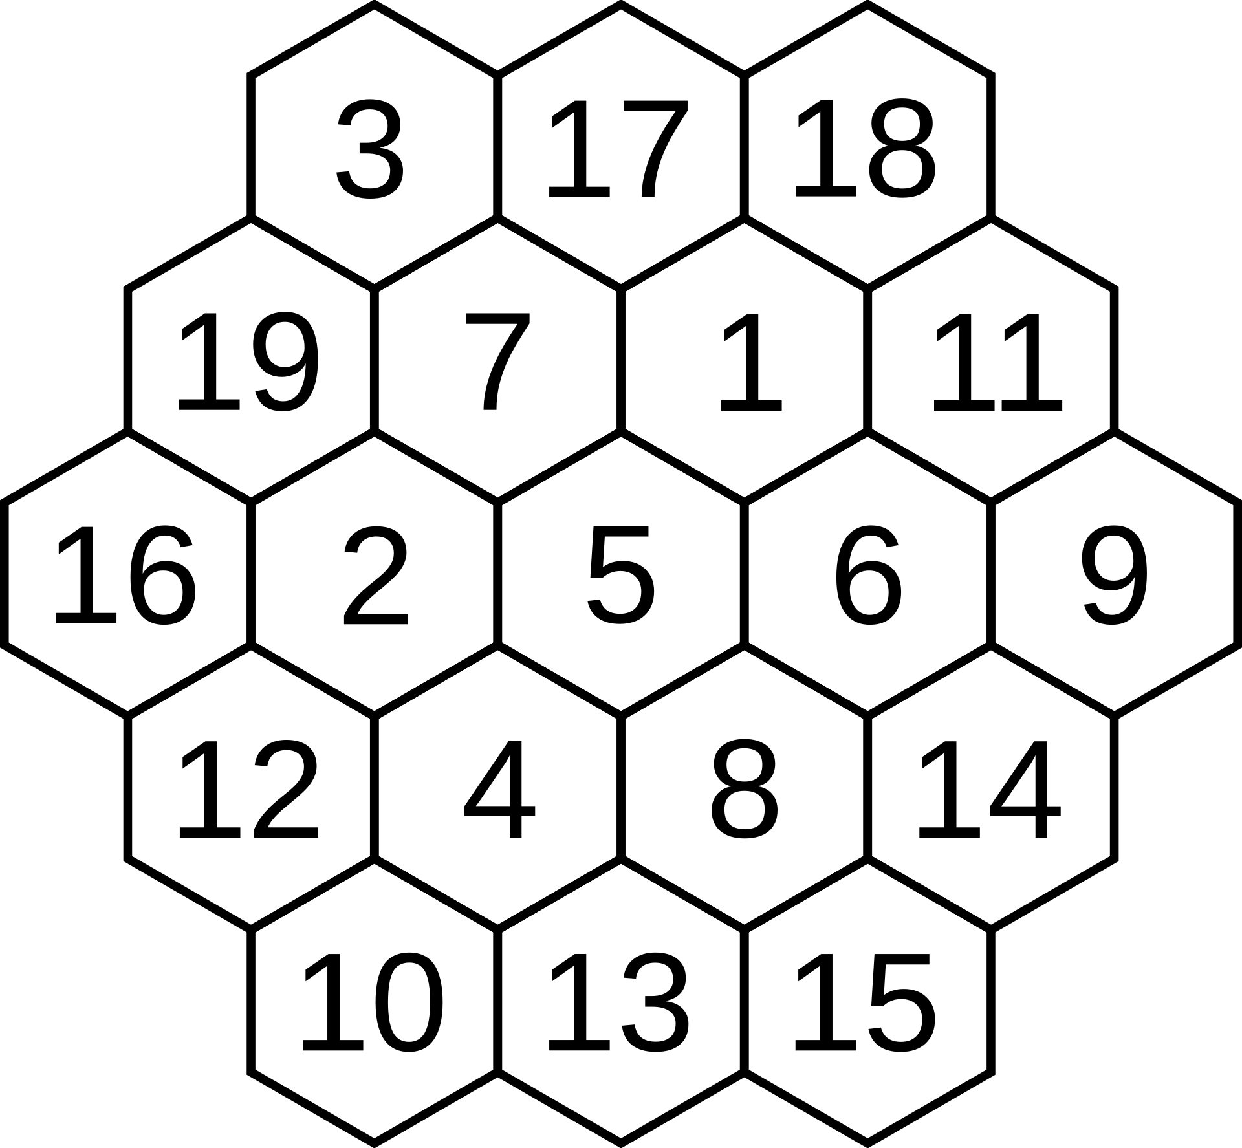
Demo:
Magic Hexagon

Slide 38
Advanced Data Handling
Extra whitespace
Arbitrary data typing
Missing values
Duplicate records
Typos
Inconsistent formats
Level 1
Level 2
…
Level 11

Slide 39
Clean Data? No, Pristine Data!
Pristine data: technical data issues have been resolved + ensure logical consistency
df = pd.DataFrame(
[
("a", "b", 1.1),
(1, "c ", 1.9),
(3, 1, 10),
]
)
mixed int/float!
mixed str/int!
trailing whitespace!

Slide 40
Clean Data? No, Pristine Data!
Pristine data: technical data issues have been resolved + ensure logical consistency
df = pd.DataFrame(
[
("a", "b", 1.1),
(1, "c ", 1.9),
(3, 1, 10),
]
)
import gams.transfer as gt
m = gt.Container()
a = gt.Parameter(
m,
"a",
["*", "*"],
records=df,
)
mixed int/float!
mixed str/int!
trailing whitespace!

Slide 41
Clean Data? No, Pristine Data!
Pristine data: technical data issues have been resolved + ensure logical consistency
df = pd.DataFrame(
[
("a", "b", 1.1),
(1, "c ", 1.9),
(3, 1, 10),
]
)
import gams.transfer as gt
m = gt.Container()
a = gt.Parameter(
m,
"a",
["*", "*"],
records=df,
)
mixed int/float!
mixed str/int!
trailing whitespace!
Enforce structure
Harmonize Types
Efficient storage

Slide 42
Clean Data? No, Pristine Data!
Pristine data: technical data issues have been resolved + ensure logical consistency
In [1]: a.records
Out[1]:
0 1 value
0 a b 1.1
1 1 c 1.9
2 3 1 10.0
In [16]: a.getUELs()
Out[16]: ['a', '1', '3', 'b', 'c']
*UELs()
The best little methods you didn’t know you need
Internally:
Categorical columns!
str-only categories!
rstrip whitespace!

Slide 43
Clean Data? No, Pristine Data!
String manipulation: casefoldUELs(), upperUELs(),...
Set/Get: addUELs(), setUELs(), getUELs()
Modify: removeUELs(), renameUELs(), reorderUELs()
Operate at dimension, symbol and container levels

Slide 44
Clean Data? No, Pristine Data!
String manipulation: casefoldUELs(), upperUELs(),...
Set/Get: addUELs(), setUELs(), getUELs()
Modify: removeUELs(), renameUELs(), reorderUELs()
Operate at dimension, symbol and container levels
*UELs() make categorical data structures easy

Slide 45
Wrap Up
Generates mathematical models (not instances)
GAMSPy leverages a GAMS backend
Access a broad set of state-of-the-art optimization solvers
Unique and streamlined way to completely tasks
GAMSPy works seamlessly with GAMS MIRO, GAMS Engine, and NEOS (local machines vs. cloud/AWS machines)
GAMSPy is fully installable with one line – pip install gamspy

Slide 46
GAMSPy – Under the Hood
GAMS lives as a separate process behind the scenes
Multiple Containers will spawn multiple GAMS processes
Every time the Container changes the changes are synch’d with GAMS
GAMSPy is tuned to move data in bulk, merge operations are expensive
There can be performance implications

Slide 47
Selective Synchronization
import gamspy as gp
m = gp.Container()
i = gp.Set(m, "i", records=range(1000))
f = gp.Parameter(m, domain=i)
f["0"] = 0
f["1"] = 1
f.synchronize = False
for n in range(2, 1000):
f[str(n)] = f[str(n - 2)] + f[str(n - 1)]
f.synchronize = True

Slide 48
Selective Loading on Solve
import gamspy as gp
m = gp.Container()
# model here
model.solve(load_symbols=[x])

Slide 49
Demo:
Profiling (w/ bonus lag & lead)
Design a set of dice that on average:
Die N beats die N+1
Die N beats die 1

Slide 50
Debugging
Can access all GAMS-like files (gms, lst, log, etc…)
Specify working_directory
from gamspy import Container
m = Container(working_directory=".")
# < Model >
model.solve()

Slide 51
Come see us!
Our Booth
Wed: 935am Optimization Modeling Software I

Slide 52
Custom Object Creation = Convenience
Symbols hold references to other symbols
What if a Symbol changes? → GT can overwrite!
m = gt.Container()
i = gt.Set(m, "i", records=list("abc"))
j = gt.Set(m, "j", i, records=list("ab"))
# j hold a reference to i
print(id(i) == id(j.domain[0]))
True
# call constructor -> j still has valid link to i
i = gt.Set(m, "i", records=list("abcdef"))
print(id(i) == id(j.domain[0]))
True
Why is this helpful?
Jupyter environments
constantly running cells out of “order”
Maintains links for consistent Container
Helps flatten the learning curve

Slide 53
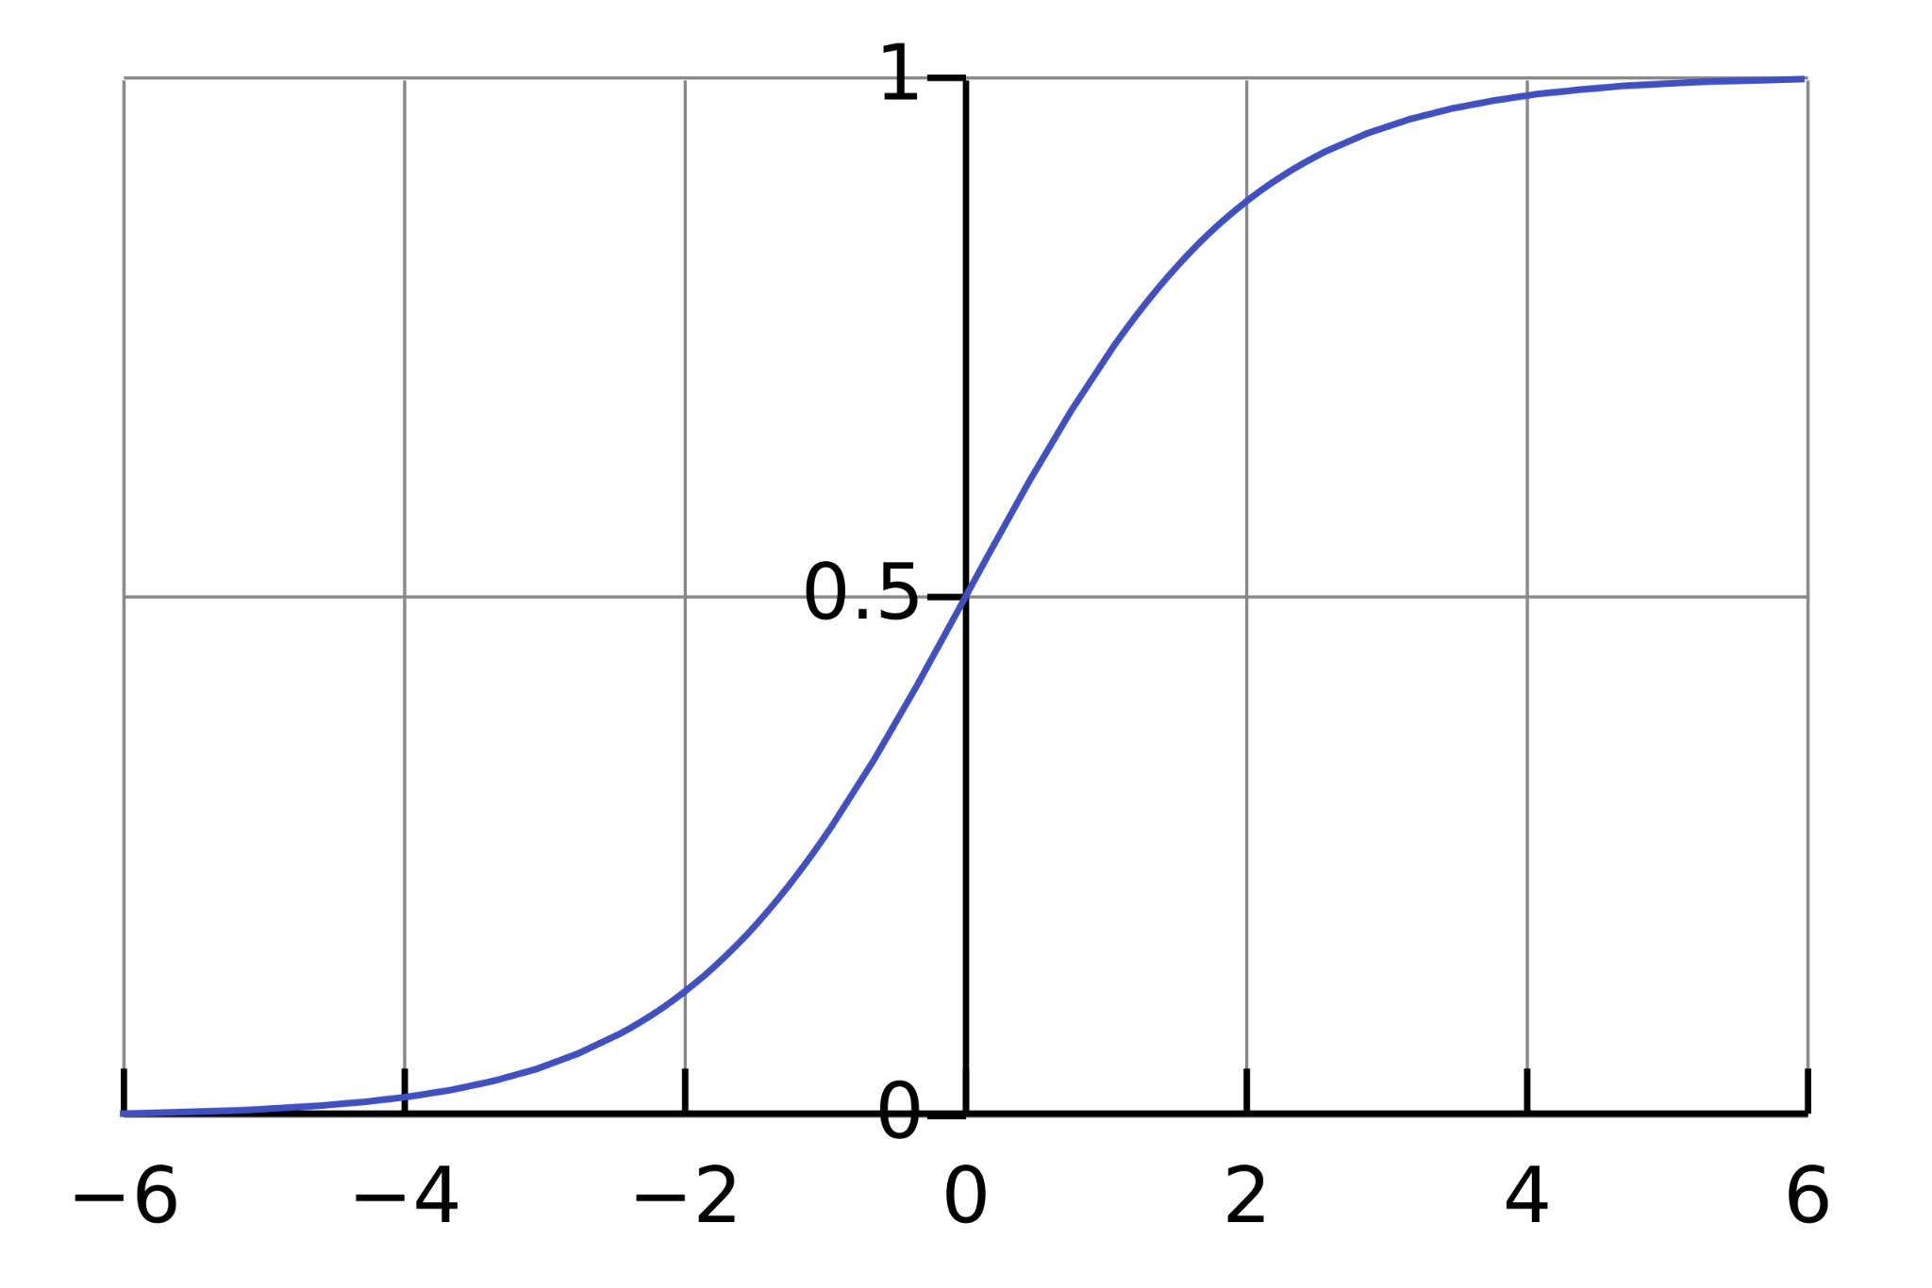
Demos:
Fitting the Logistic Function
(w/ bonus toDense & functions)
Frozen Solves

